Slide 1






E-TCHA.com
+
Search me….
Sign up
Login
Welcome to xyz
The best freelancing
site to get jobs
Learn More…
© e-tcha.com 2020

Slide 2


E-TCHA.com
Search me….
Sign up
Login
I have been using xyz for 5 years now and I love it
Learn More…
© e-tcha.com 2020

Slide 3


E-TCHA.com
Search me….
Sign up
Login
Marketing
Research
Writing
Data Analysis
Programming
Vocational Training
Exams and Tests
Contact Us
Account
Xyz gives you the hands on skills and network you need
Learn More…
© e-tcha.com 2020

Slide 4


Sign Up
Sign up to Start Learning
Username
Mobile Number
+254
Password
Confirm password
Sign up as student
Next

Slide 5


Hello Paul207 Please verify it’s you.
We’ve sent a verification code to +254xxxxxxxx
Enter code…
Resend code
Wrong number?
Submit
© e-tcha.com 2020

Slide 6


Login
Username:
Password:
Forgot Password
Enter
© e-tcha.com 2020

Slide 7







E-TCHA.com
Get Started…
Home/exams/all
My account
ALL
CLASS 8
FORM 4
CHEMISTRY
PHYSICS
MATHS
20.00
20.00
20.00
20.00
Begin
Unlock
Unlock
Unlock
© e-tcha.com 2020

Slide 8




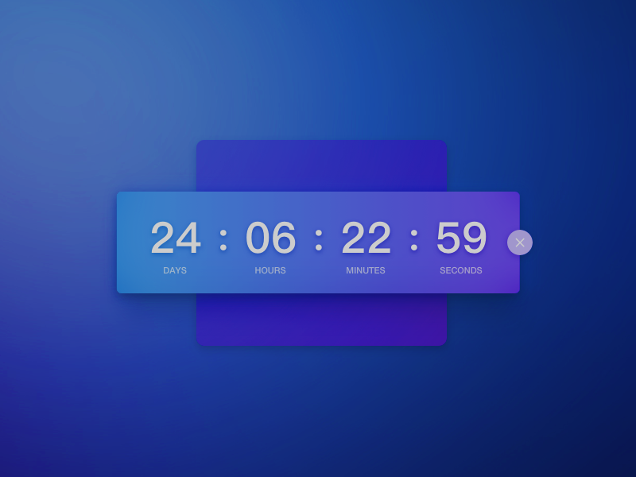
E-TCHA.com
Class 8…
Home/exams/class8
My account
ALL
CLASS 8
FORM 4
MATHS
ENGLISH
20.00
20.00
20.00
20.00
Begin
Unlock
Unlock
Unlock
© e-tcha.com 2020

Slide 9




E-TCHA.com
Science…
Home/exams/class8
My account
Maths
English
Science
ALL
CLASS 8
FORM 4
Kiswahili
Social
C.R.E /I.R.E
© e-tcha.com 2020

Slide 10

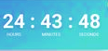



Back
SUBJECTS
Click on year of choice
1999 | 2010 | 2015
2000 | 2011 | 2016
2001 | 2012 | 2017
2002 | 2013 | 2018
2003 | 2014 | 2019
2004 | 2015 | 2020
MATHS
ENGLISH
K.C.P.E
JESMA
SCIENCE
KISWAHILI
SOCIAL STUDIES
WEZOJE
MOCKS
CRE/IRE
Time
Remaining…
TAP
JIP
Logout
© e-tcha.com 2020
Terms and conditions

Slide 11


E-TCHA.com
Science…
Home/exams/class8
K.C.P.E 2018 SCIENCE
11. Wheelbarrow is an example of what class of levers?
A. First
B. Second
C. Third
D. Fourth
12. Wheelbarrow is an example of what class of levers?
A. First
B. Second
C. Third
D. Fourth
13. Wheelbarrow is an example of what class of levers?
A. First
B. Second
C. Third
D. Fourth
PREV
3/11
NEXT
© e-tcha.com 2020

Slide 12
E-TCHA.com
Science…
Home/exams/class8
K.C.P.E 2018 SCIENCE
48. Wheelbarrow is an example of what class of levers?
A. First
B. Second
C. Third
D. Fourth
49. Wheelbarrow is an example of what class of levers?
A. First
B. Second
C. Third
D. Fourth
50. Wheelbarrow is an example of what class of levers?
A. First
B. Second
C. Third
D. Fourth
PREV
11/11
RESULTS
© e-tcha.com 2020

Slide 13







E-TCHA.com
Awards…
My account
K.C.P.E 2018 SCIENCE
Score :
Time :
BACK
NEW
DOWNLOAD RESULTS

Slide 14

E-TCHA.com
Awards…
My account
K.C.P.E 2018 SCIENCE
Score :
Time :
Paul207
NEXT
RETRY IN 2 DAYS
DOWNLOAD RESULTS

Slide 15


Back
My Account
Username
My Profile
Paul207
My Services
Phone
+254xxxxxxxx
Billing
Last Seen
My Achievements
Edit profile image
2 Days Ago
Save
Logout
© e-tcha.com 2020
Terms and conditions

Slide 16
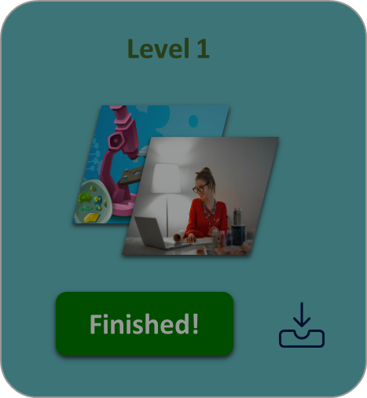
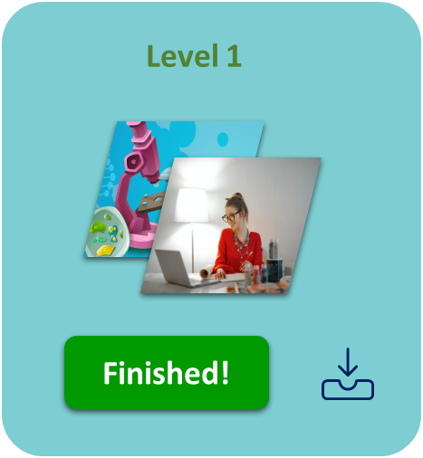
Back
My Account
Package Name
My Profile
Ml1 Intro to Marketing
My Services
Duration
6 Hours
Billing
Points Earned
My Achievements
5069
Show More…
Logout
© etcha.com 2020
Terms and conditions

Slide 17

Back
My Account
Status
Account Balance
My Profile
199.04
My Services
Pending Exams
0
Billing
Completed Exams
199.04
Active
My Achievements
67
Deposit
Logout
© e-tcha.com 2020
Terms and conditions

Slide 18



My Account
Exams Completed
My Profile
146
My Services
Pending Exams
2
Billing
Revoked
My Achievements
7
28 Trophies
67 Badges
Logout
© e-tcha.com 2020
Terms and conditions

Slide 19




E-TCHA.com
Contact Us
Email:
Subject:
Message
07123456789
Freelancer.com
Freelancer.com
Freelancer.com
© e-tcha.com 2020

